Slide 1
Micro Mini Marble Madness
David Wright
CPSC 4387
Fall 2024
Prof Basu

Slide 2
Introduction
Concept
Network Environment
Spawning
Marble Scoring
Turn Manager
Player Scoring
Conclusion
Demonstration

Slide 3
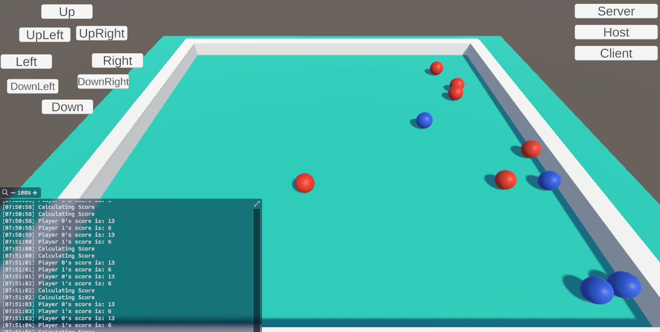
Concept
Micro Mini Marble Madness is a game that pits networked players against each other to score points by hitting other players’ marbles with their own
Players choose a direction and speed with which to drop their marble
Players gain points for hitting other players’ marbles
Players lose points for striking their own marbles or the walls

Slide 4
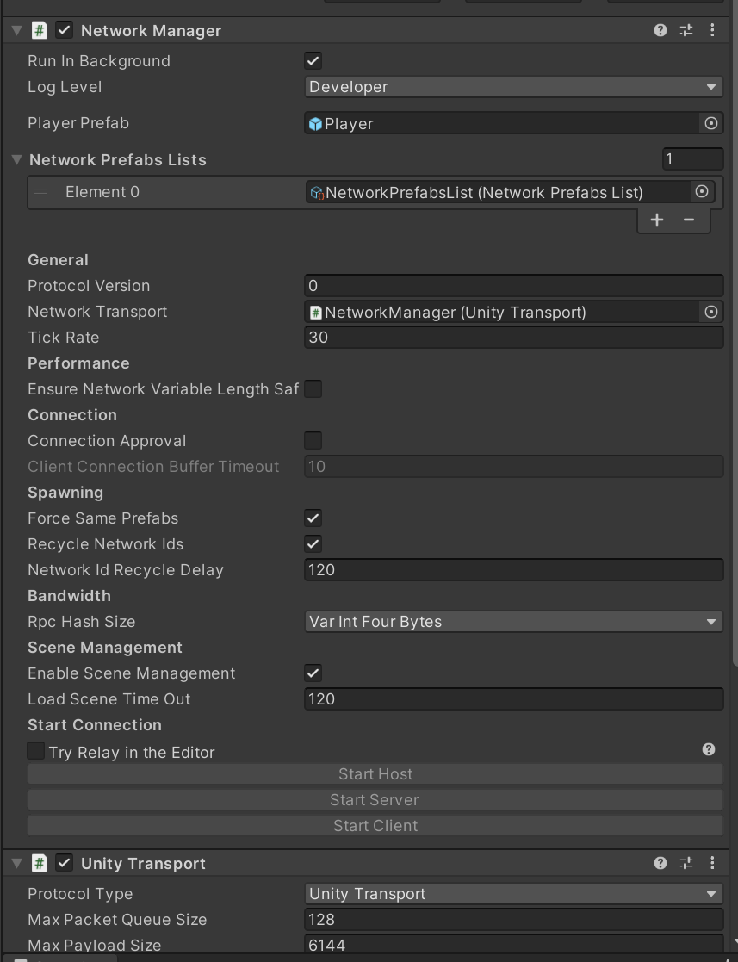
Network Environment
Netcode for Game Objects
Unity Transport
Network Prefabs
Empty player object
Marbles and materials

Slide 5
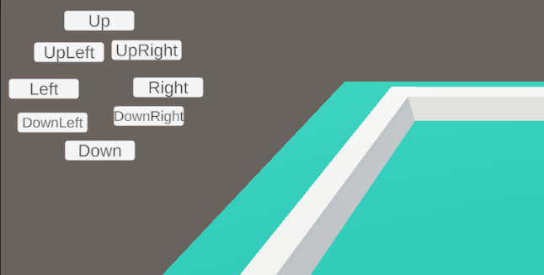
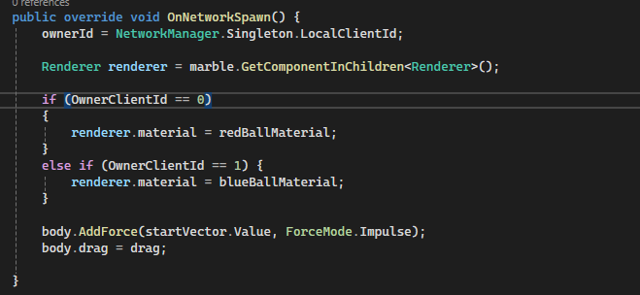
Spawning
Buttons for direction
Buttons for velocity
Instantiate through the player with an initial vector

Slide 6
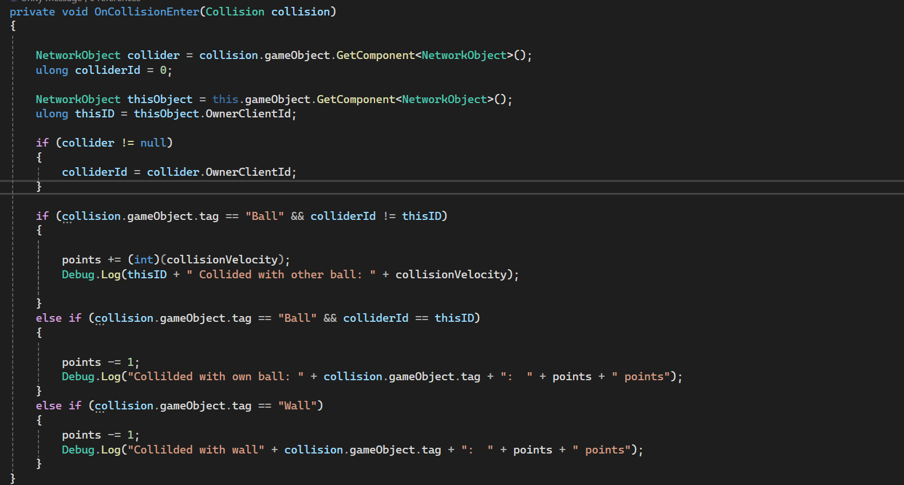
Marble Scoring
Marbles score points when they strike an opponent’s marble
Lose points when the strike a wall or their own team’s marble

Slide 7
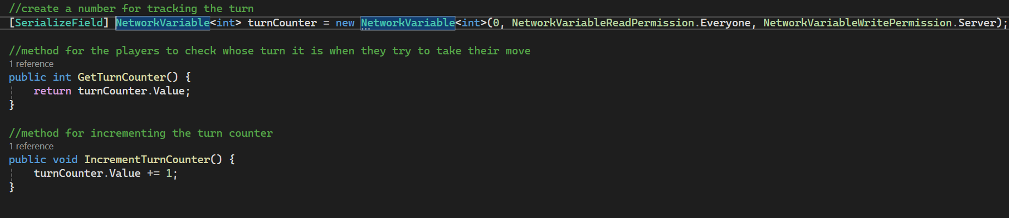
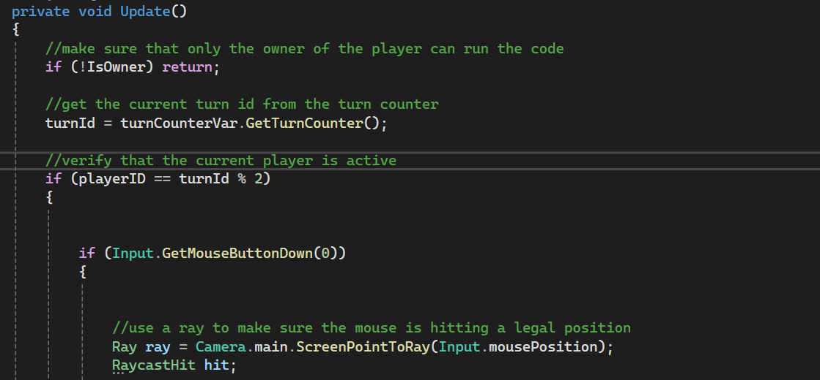
Turn Manager
Turn manager has a counter that increases each time a player spawns a marble
Player checks to see if they are the owner of the player and the active player before spawning

Slide 8
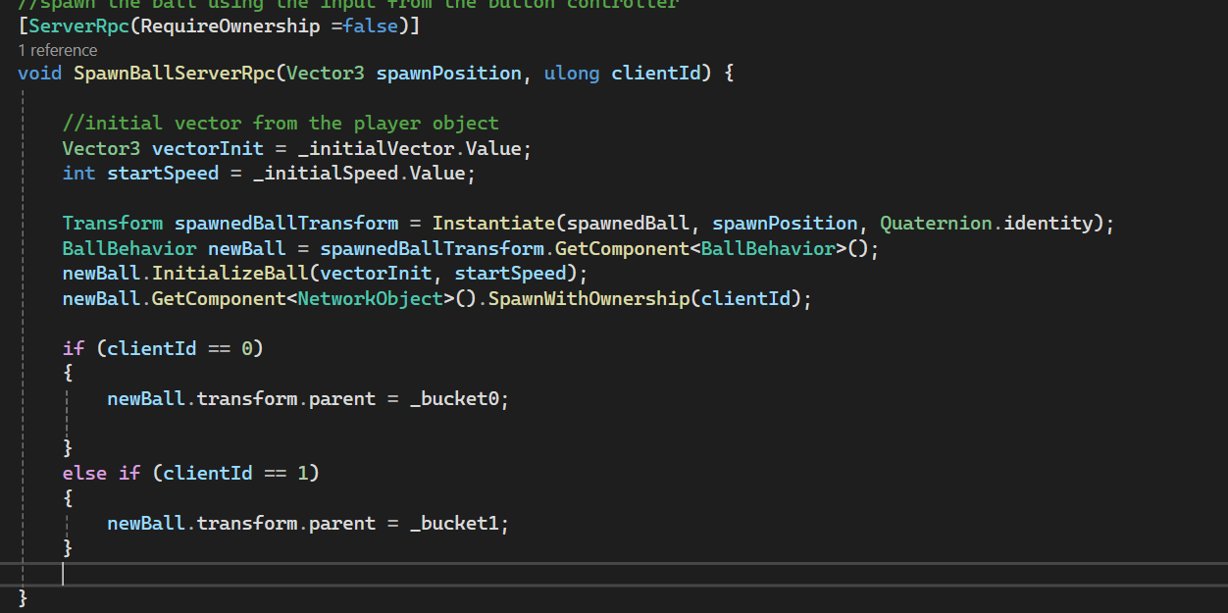
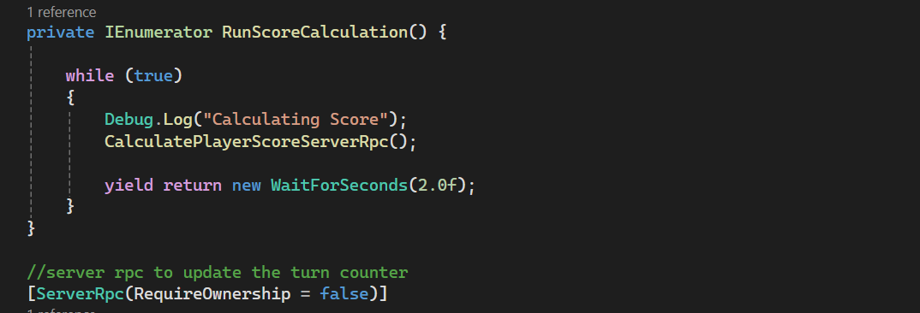
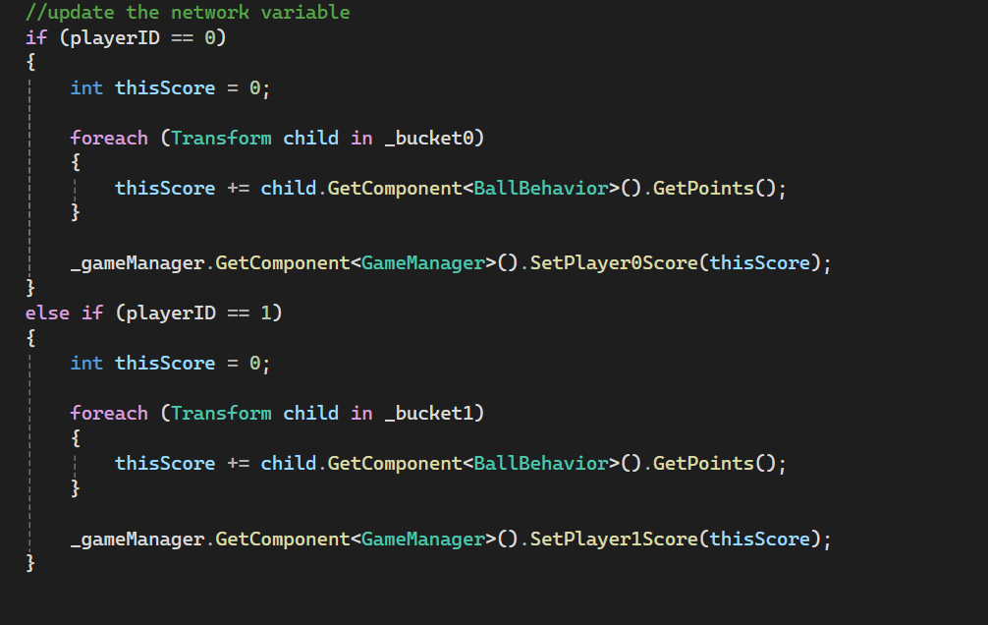
Player Scoring
When players spawn their marbles, they are placed into “bins” in the game manager
RunScoreCalculation() coroutine is constantly tracking both players’ scores and sending the information to the server

Slide 9
Conclusion
Concept
Network Environment
Spawning
Marble Scoring
Turn Manager
Player Scoring
Conclusion
Demonstration

